Slide 1

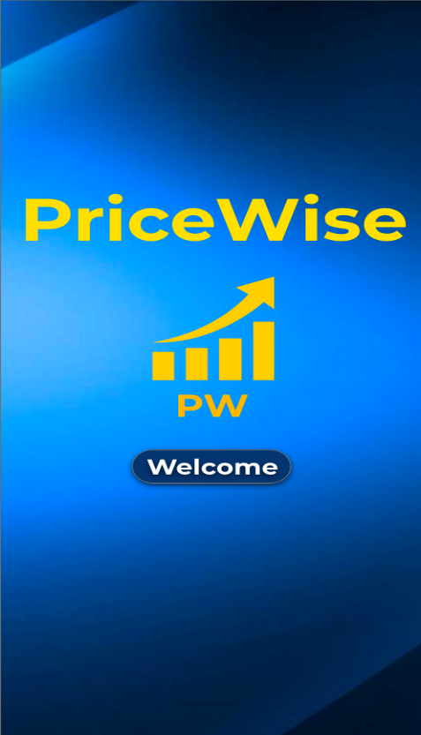
Welcome to PriceWise

Slide 2

PriceWise Team members
Zohair Ansari - Chief Executive Officer (CEO)
Nabil Abdil - Chief Technology Officer (CTO)
Ferdinand Nokom - Chief Operations Officer (COO)
Dean Sumangil - Chief Marketing Officer
Mhelka Tiodianco - Head of Human Resources

Slide 3

Our Story : PriceWise
Vision Statement:
“Spend wise by getting the best price.”
Rationale:
Take advantage of the rapidly growing online shopping market but ensuring the best online purchase deals

Slide 4

Target Market
Potential customer age group: 18 - 60 years old
Potential Users:
shoppers able to do transactions online regardless of frequency.
Potential Market size:
~16.8 million that have made an online purchase within the year

Slide 5



Competitors
Honey: has mobile app/browser extension, provides promo codes,deals with major retailers
CamelCamelCamel: Website that only tracks Amazon prices
Keepa: has mobile app/browser extension, tracks prices across major retailers only

Slide 6
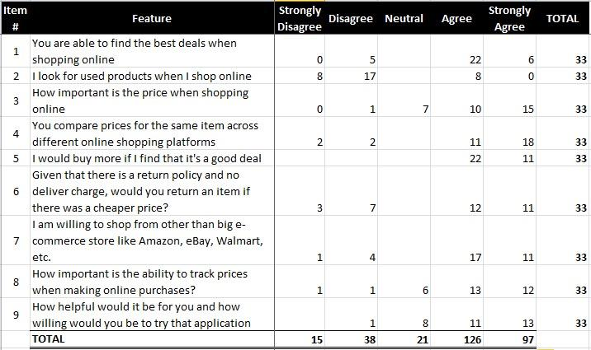
Survey Results

Slide 7
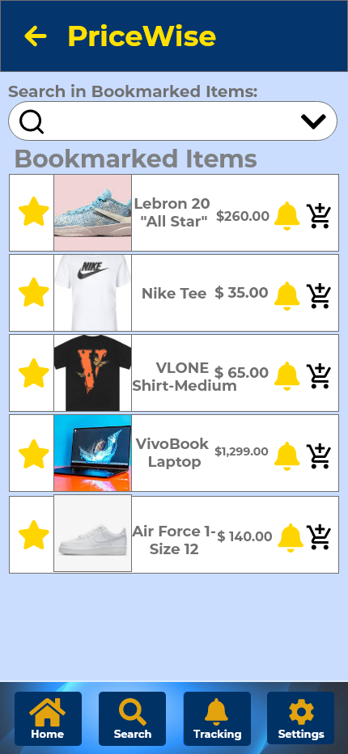
Survey Results
More than 66% of the respondents find the best deals online.
53% of the respondents compare prices across different online shopping platforms.
More than half of the respondents missed out on a good deal because they didn’t know there was a promo.
63% are unable to keep track of the products they wanted to buy.
Our app has the functionalities of bookmarking, notifications, and daily promotions and offers to address consumer needs.

Slide 8
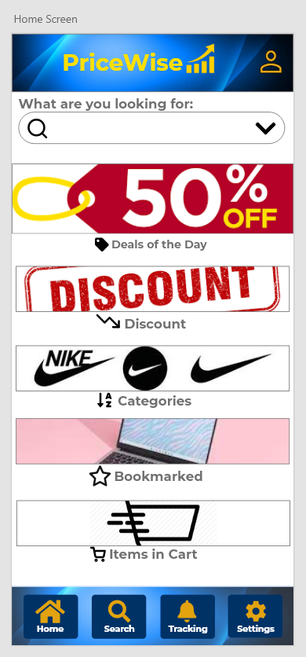
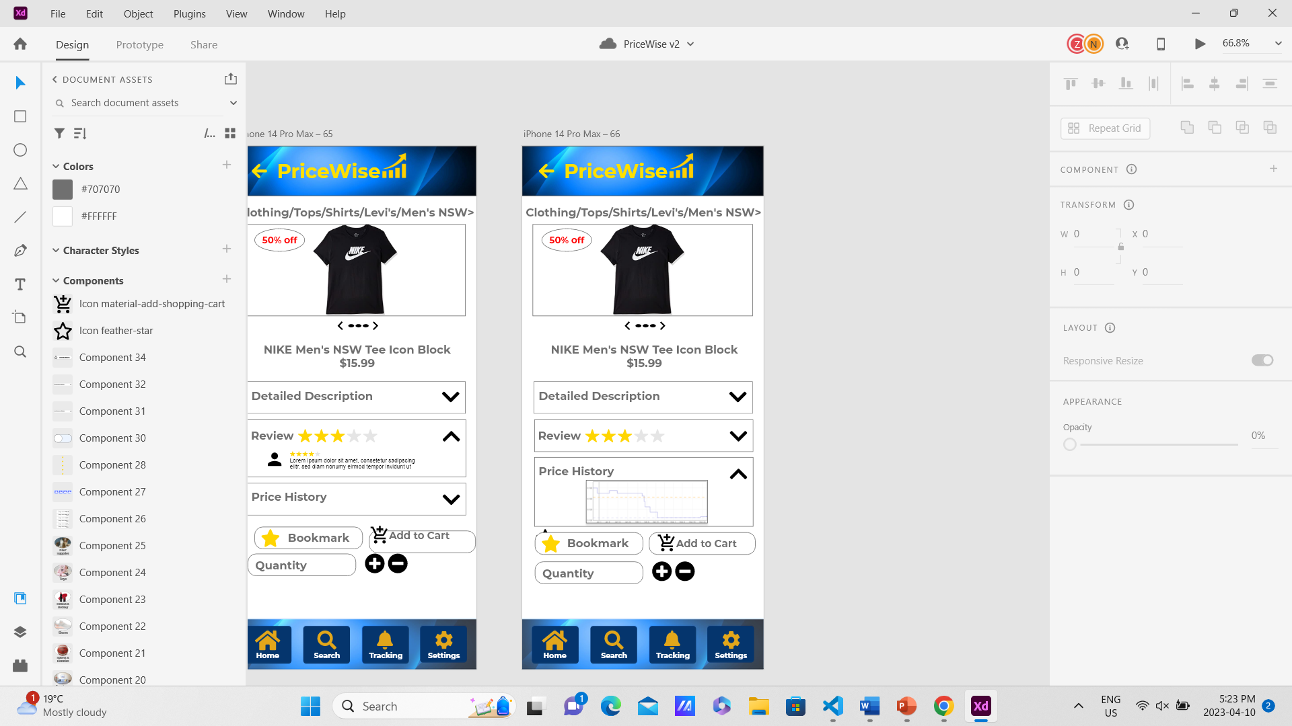
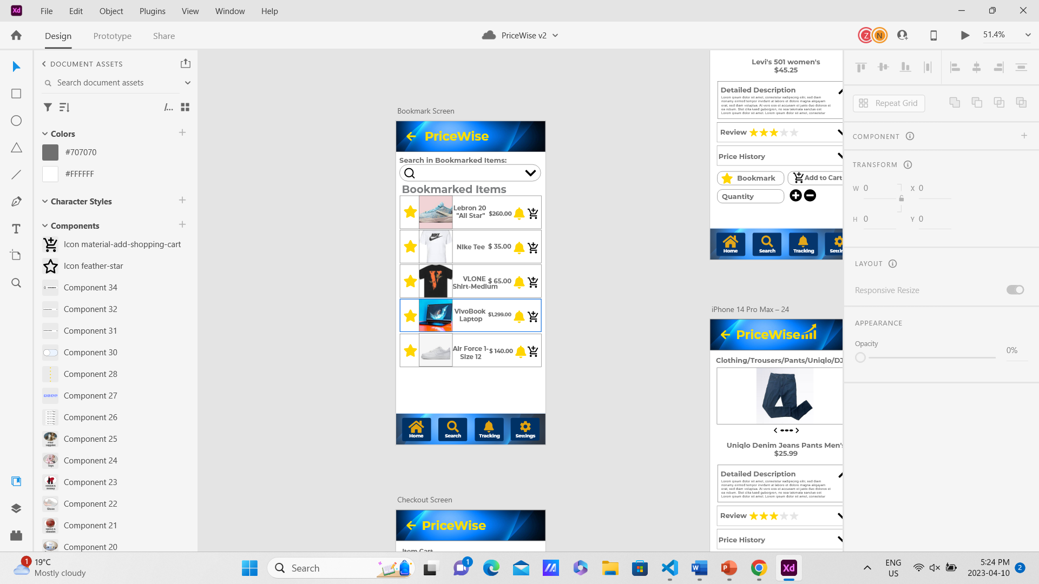
Initial Design Pages

Slide 9
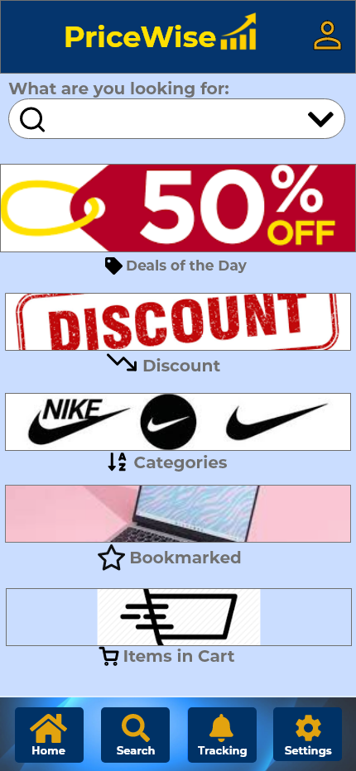
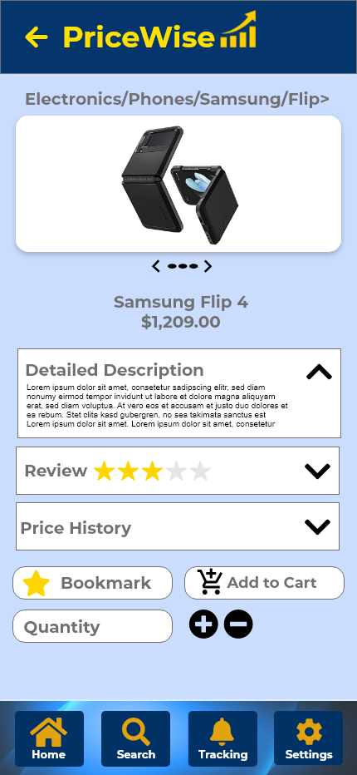
User Testing Results
Pros
Cons
Navigation – user-friendly
Functionality – everything works as intended
Detail-Oriented – all information needed was visible
Variety of choices were available
Intuitiveness – initial “Go Back” button was changed to an icon.
Aesthetic design can be improved

Slide 10

Lean Canvas

Slide 11
Customer Segments:
Shoppers looking for the best deals/price comps, particularly for high-ticket items.
People who want to track the price of a product over time.
People who want to know the price history before making a purchase.

Slide 12
Problem Statement
Difficulty in finding the best deals and prices
Lack of historical price data
Difficulty in tracking multiple products
Difficulty in making informed purchasing decisions

Slide 13
Unique Value Proposition:
High Level Concept: Shop smarter with our time machine for prices and Never Overpay Again.
Provide detailed and accurate price history and analytics.
Compare and track prices, including real-time alerts for price drops and deals.
Personalized recommendations and alerts based on users' preferences and browsing history.
Ability to create and share product lists.

Slide 14
Solution:
Provide a price tracking app which finds the best deals and tracks and displays history of the product prices.
Use data from major e-commerce websites to display the price graph of products so the user can purchase at its cheapest.
Bookmarking function will give users ability to track selected products and access to updated pricing/promo information for their selection.
Give real-time price drop/deal alerts, deals page and price history graphs to help users decide the right time to make the decision.

Slide 15
Channels:
Currently: Mobile app available on iOS and Android platforms
Website and Chrome Extension to be developed in pipeline

Slide 16
Revenue Streams:
Affiliate marketing, through partnerships and commission on sales made through referral.
Premium subscriptions for full access of features.
Advertising and sponsored content within app.
Handle Delivery and Shipping for partners/retailers (in pipeline)

Slide 17
Cost Structure:
Data Storage & Processing costs(Cloud)
Employee salaries
R&D costs: new functionalities and platform maintenance
Advertising/marketing: social media ads, email campaigns, and influencer partnerships.
Overhead Expenses i.e: rent, internet, and utilities.
.

Slide 18
Key Metrics:
Number of Downloads
User Retention: The percentage of users who continue to use the app over time.
Revenue: The amount generated through advertising, affiliate marketing, and premium subscriptions, delivery.
User Engagement: Amount of time users spend on the app per session

Slide 19
Conversion Rate:
Percentage of users who make a purchase through app,number of subscriptions

Slide 20

Conclusion
User testing is key to improve the app.
Even the smallest details can help the app’s appearance and user experience.
Tested our assumptions
Be adaptable

Slide 21
Thank you
QUESTIONS?

